Slide 1
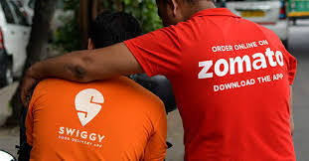

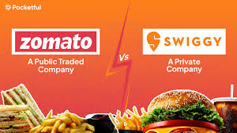
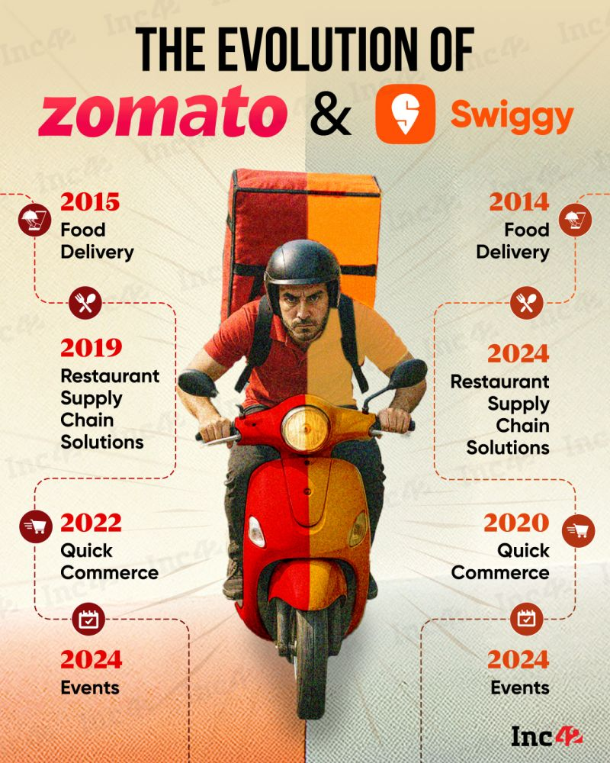
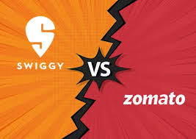
Food Delivery Orders Data Insights

Slide 2

Introduction & Project Goal
Analyzes food delivery orders across Indian cities to
reveal trends, customer behavior, and restaurant performance.
Structured around key insights and metrics.
Delivery Performance Metrics
Data Preprocessing
Average Delivery Time across all cities (28 minutes)
Fastest City (Mumbai: 22 minutes) and Slowest City
(Pune: 35 minutes)
( Null Handling for Customer Name, Restaurant Name, Quantity, Rating, Price, and Delivery Time)
Restaurant Performance Analysis
Customer Satisfaction Ratings
Overall Average Rating and Rating Distribution
Top Performing Restaurants by Rating
(e.g., Domino's Pizza at 4.2)
Top 5 Restaurants by Average Rating
Restaurant Revenue Analysis
Customer spend & Revenue Insights
Key Visualizations
Customers who spent more than the average amount
(High-Value Customers)
Most Popular Payment Method (Cash, UPI, Card)
Total Revenue (₹2.4L) and Average Order Value (₹385)
Time Series Line Graph: Hourly Order Volume
Key Metrics: Average Delivery Time & On-Time Rate

Slide 3
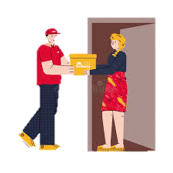

INTRODUCTION
This project analyzes food delivery orders across multiple Indian cities to uncover trends, customer behaviors, and restaurant performance.

Slide 4

UPDATE food_data
SET CustomerName = 'Unknown'
WHERE CustomerName IS NULL;
UPDATE food_data
SET Rating = 0
WHERE Rating IS NULL;
UPDATE food_data
SET Quantity = 0
WHERE Quantity IS NULL;
UPDATE food_data
SET Price = 0.0
WHERE Price IS NULL;
UPDATE food_data
SET RestaurantName = 'Unknown'
WHERE RestaurantName IS NULL;
UPDATE food_data
SET OrderDate = '2025-01-01'
WHERE OrderDate IS NULL;
UPDATE food_data
SET DeliveryTime = '0 mins'
WHERE DeliveryTime IS NULL;
UPDATE food_data
SET FoodItem = 'Unknown'
WHERE FoodItem IS NULL;

Slide 5





SELECT
RestaurantName,
ROUND(AVG(Rating), 2) AS Average_Rating,
COUNT(*) AS Total_Reviews
FROM food_data
GROUP BY RestaurantName
ORDER BY Average_Rating DESC
LIMIT 5;
TOP 5 RESTAURANTS BY AVERAGE RATING

Slide 6
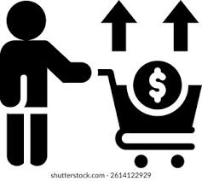
SELECT Customername, SUM(Price) AS TotalSpent
FROM food_data
GROUP BY Customername
HAVING SUM(Price) > (
SELECT AVG(CustomerTotal)
FROM (
SELECT SUM(Price) AS CustomerTotal
FROM food_data
GROUP BY Customername
) AS Sub
);
FIND CUSTOMERS WHO SPENT MORE THAN THE AVERAGE AMOUNT
Using SQL, we identified customers whose total spending exceeds the overall average.”
“High-value customers represent our most profitable segment and can be targeted for loyalty programs.”
“This analysis helps prioritize marketing and retention efforts.”

Slide 7

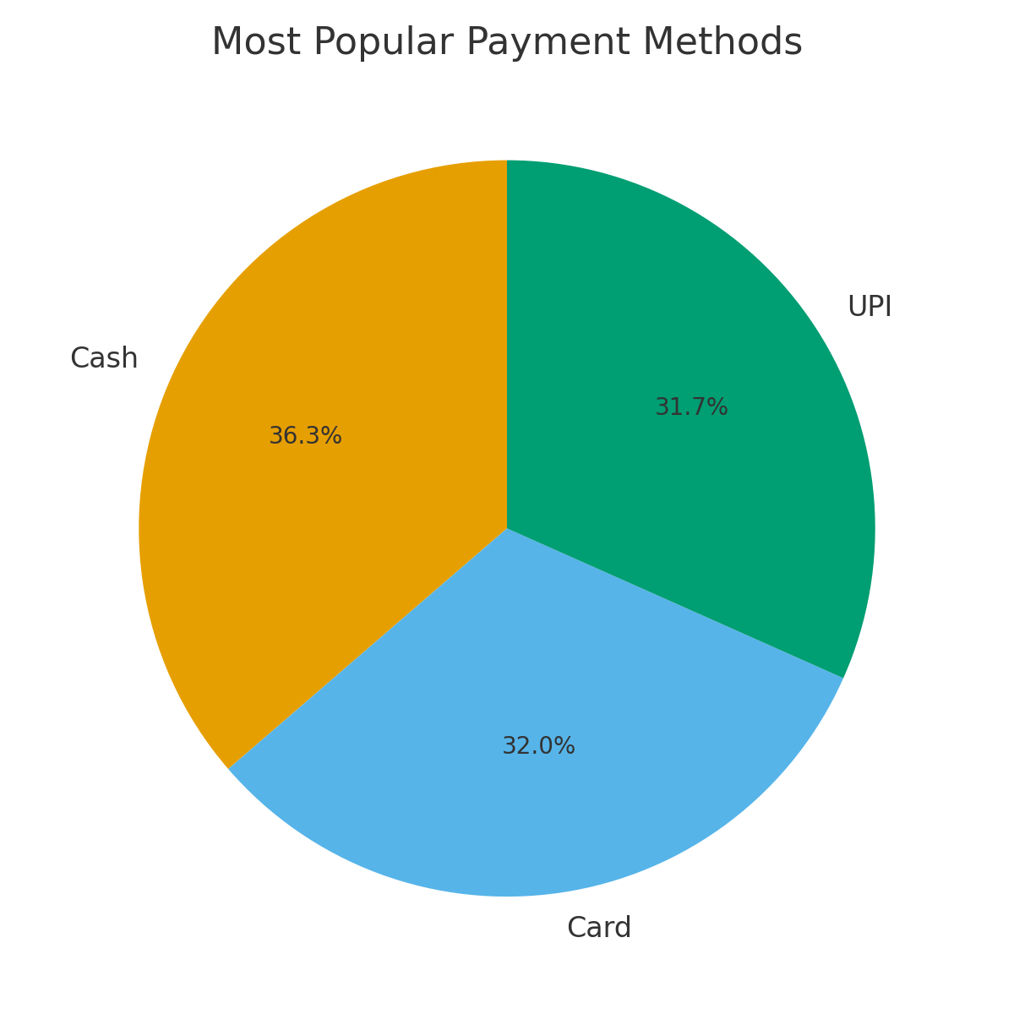

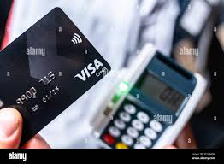



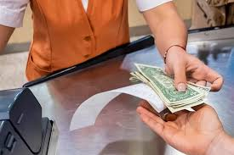
SELECT PaymentMethod, COUNT(*) AS Count
FROM food_data
GROUP BY PaymentMethod
ORDER BY Count DESC
MOST POPULAR PAYMENT METHOD

Slide 8




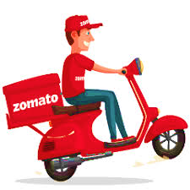
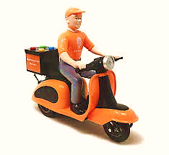
Delivery Performance Metrics
Average Delivery Time
28 minutes across all cities, meeting industry standards for customer satisfaction
Fastest City: Mumbai
22 minutes average delivery time due to dense restaurant network and efficient logistics
Slowest City: Pune
35 minutes average delivery time, impacted by traffic conditions and restaurant density

Slide 9


Customer Satisfaction Ratings
4.2
Rating Distribution
Domino's Pizza
65% of orders rated 4-5 stars
25% rated 3 stars (neutral)
Consistent quality and fast delivery
10% rated 1-2 stars (needs improvement)
4.0
Overall satisfaction remains high with an average rating of 4.1/5 across all restaurants and food categories.
McDonald's
Reliable service across locations
Average Rating by Restaurant
SELECT RestaurantName, ROUND(AVG(Rating), 2)
AS AvgRating
FROM food_data
GROUP BY RestaurantName
ORDER BY AvgRating DESC;
3.8
Local Restaurants
Variable but authentic cuisine

Slide 10

“OUR ANALYSIS CALCULATES TOTAL REVENUE BY MULTIPLYING QUANTITY SOLD BY PRICE AND SUMMING ACROSS ALL ORDERS.”
SELECT
RestaurantName,
SUM(Quantity * Price) AS TotalRevenue
FROM food_data
GROUP BY RestaurantName
ORDER BY TotalRevenue DESC;

Slide 11
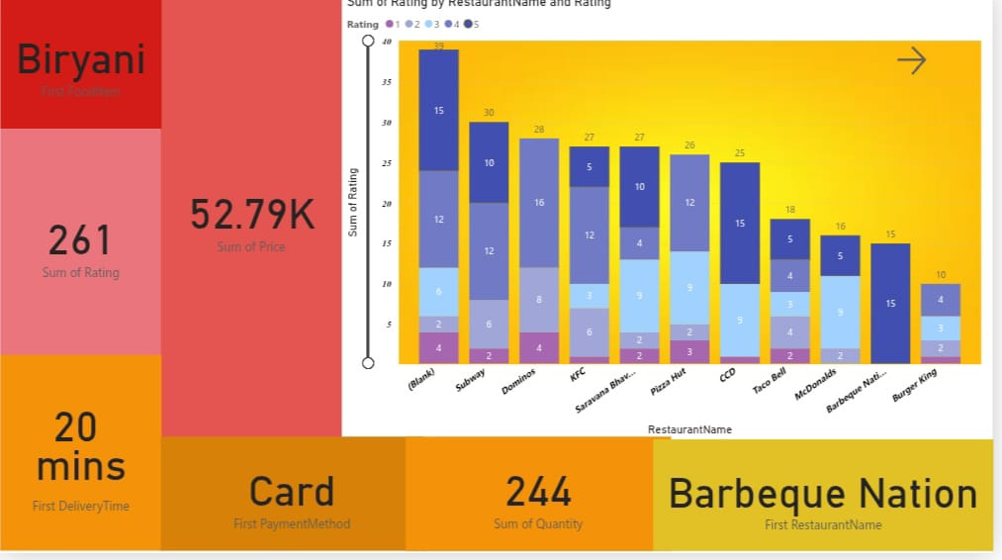
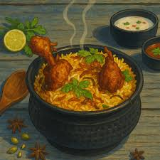


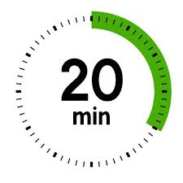



Slide 12
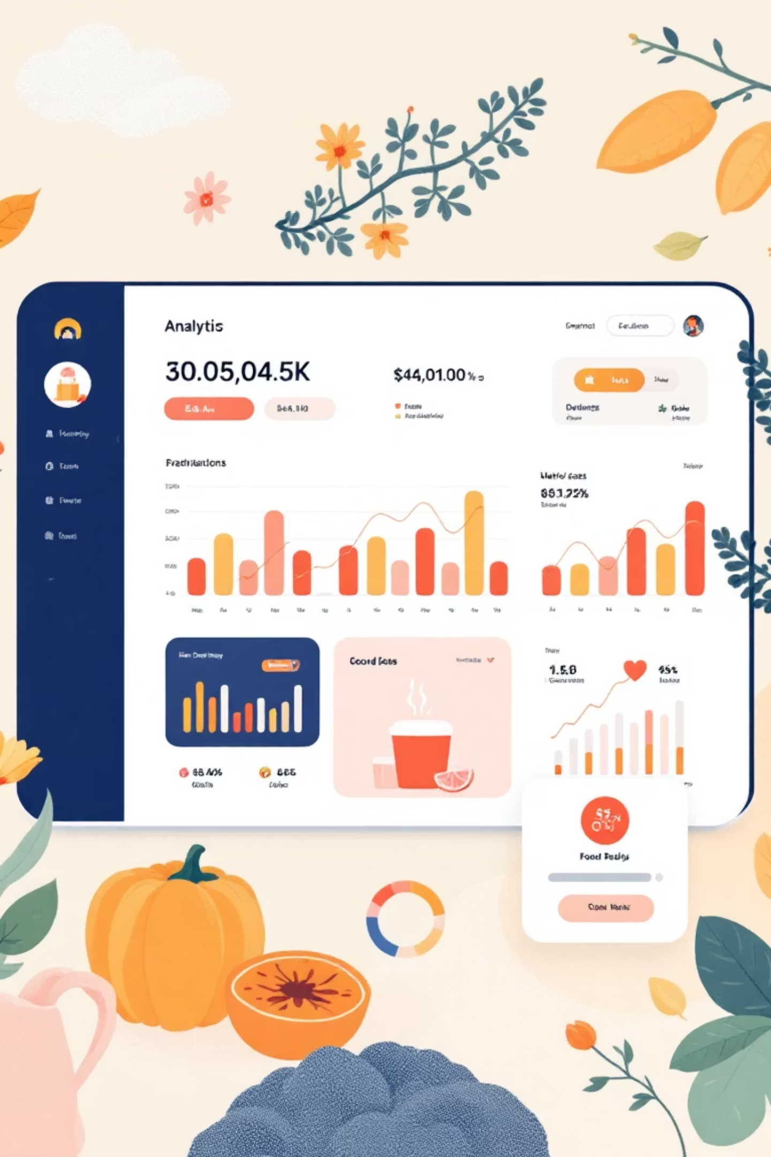
Revenue & Pricing Analysis
₹2.4L
Highest Value Orders
Priya Patel - ₹850 (Family feast order)
Total Revenue
Amit Singh - ₹720 (Corporate lunch)
Accumulated across all 200+ orders during the analysis period
Neha Gupta - ₹650 (Party catering)
Rohit Kumar - ₹580 (Weekend special)
₹385
Anjali Sharma - ₹545 (Birthday celebration)
Average Order Value
Consistent pricing strategy maintains customer accessibility

Slide 13
RELATIONSHIP DIAGRAM
Restaurants
Restaurants-id
Restaurants-city
Orders
Orders-id
Customer-id
CUSTOMERS
Customer-id
Customer-name
Restarurants-name
Customer-city
Restaurants-id
Quantity
Order-date
Delivery-time
FOOD-ITEM
Food-item
Food-item-id
CUSTOMERS → ORDERS: ONE CUSTOMER CAN HAVE MANY ORDERS. (1-TO-MANY)
RESTAURANTS → ORDERS: ONE RESTAURANT CAN HAVE MANY ORDERS. (1-TO-MANY)
FOOD ITEMS → ORDERS: ONE FOOD ITEM CAN APPEAR IN MANY ORDERS. (1-TO-MANY)

Slide 14
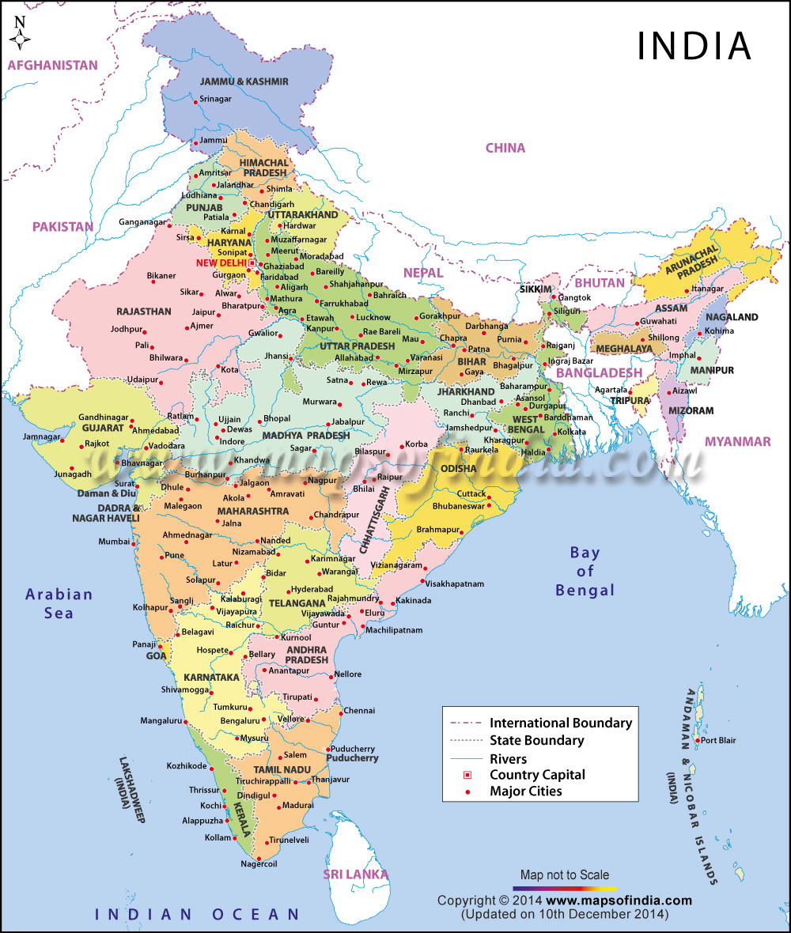
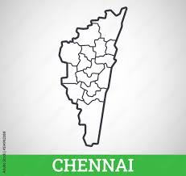


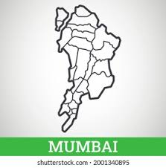


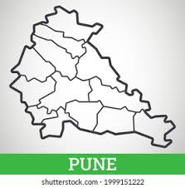
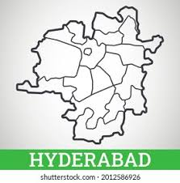
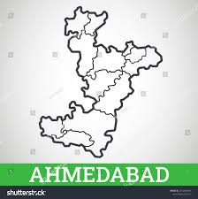

This Photo by Unknown Author is licensed under CC BY-NC-ND

Slide 15
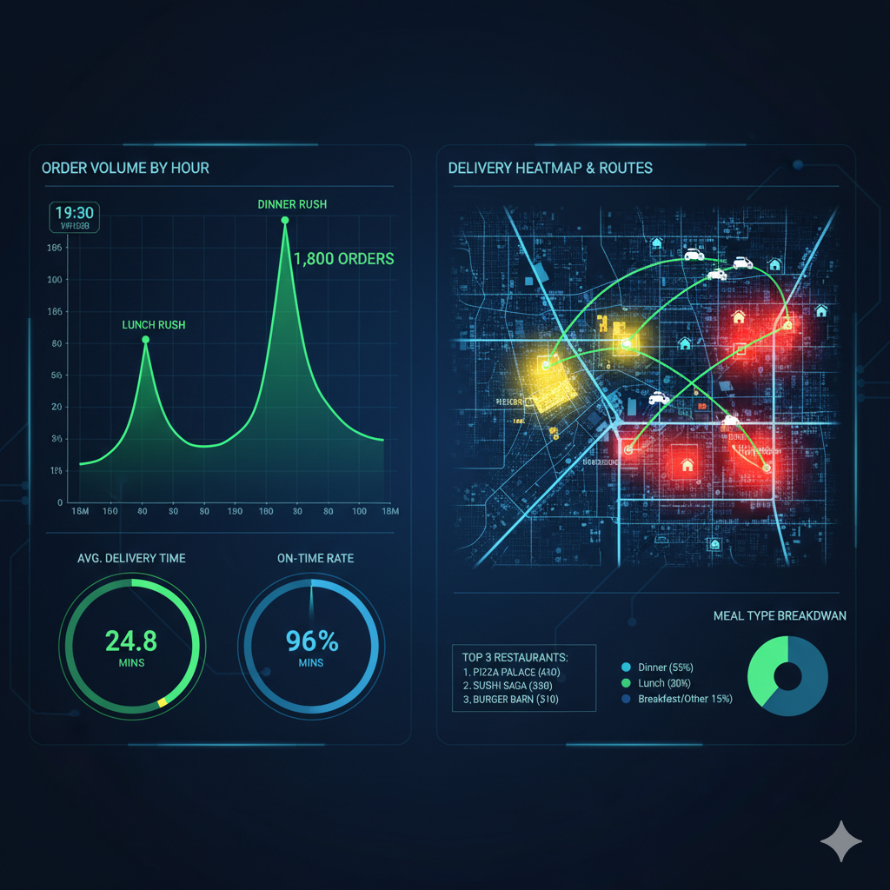
TIME SERIES LINE GRAPH: HOURLY ORDER VOLUME
KEY METRICS: AVG. DELIVERY TIME & ON-TIME RATE
HEATMAP/GEO MAP: DELIVERY HOTSPOTS & ROUTES
SELECT
DATEPART(HOUR, OrderTime) AS OrderHour,
COUNT(OrderID) AS TotalOrders,
AVG(DATEDIFF(MINUTE, OrderTime, DeliveryTime)) AS AvgDeliveryTimeMinutes,
SUM(CASE WHEN DeliveryTime <= ExpectedDeliveryTime THEN 1 ELSE 0 END) * 1.0 / COUNT(OrderID) AS OnTimeRate,
Latitude,
Longitude
FROM Orders
GROUP BY
DATEPART(HOUR, OrderTime),
Latitude,
Longitude
ORDER BY OrderHour;

Slide 16
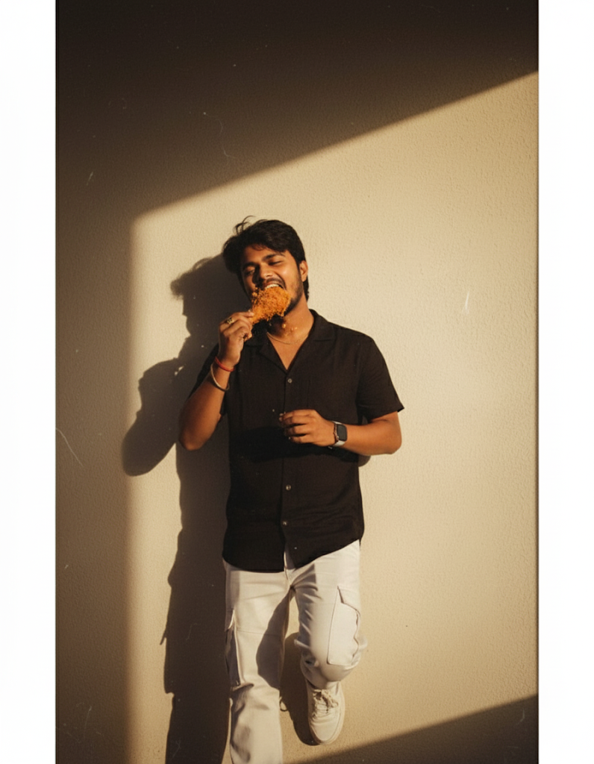
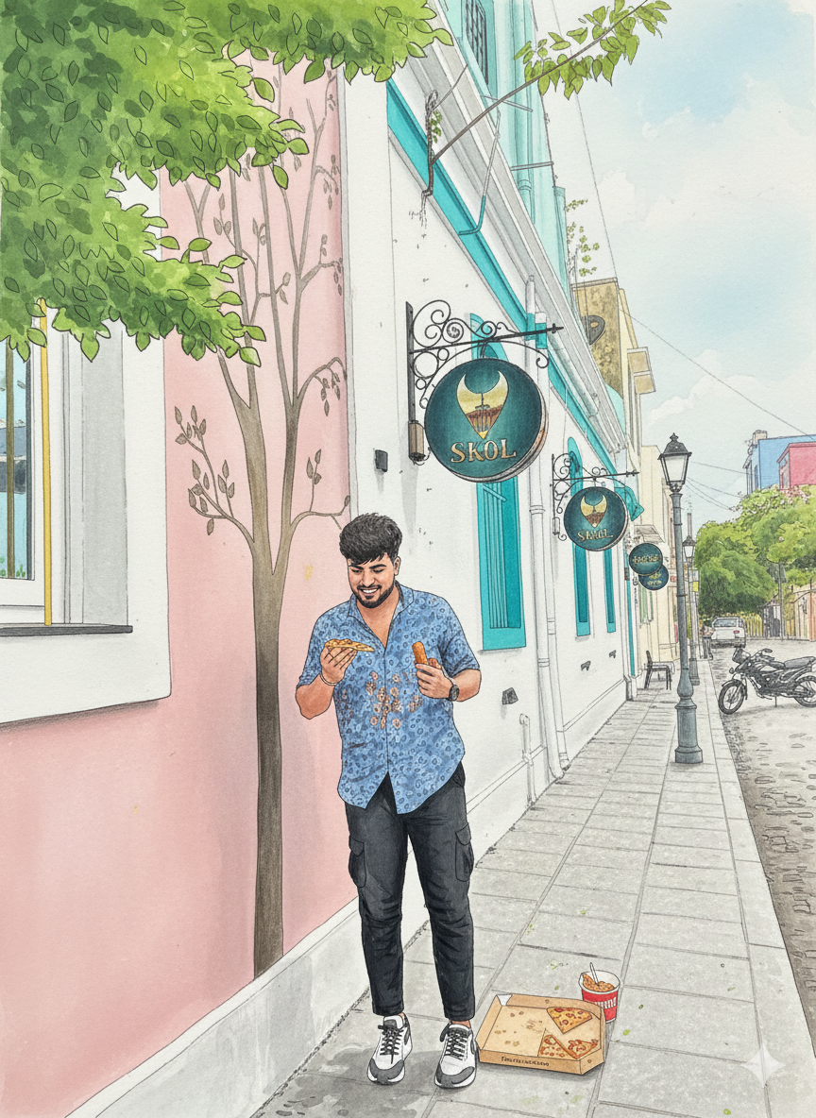
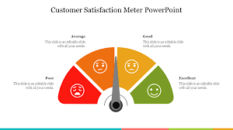
New Slide: Customer Satisfaction
Avg Rating: ⭐ 4.1 / 5 across all restaurants
Rating Distribution:
65% orders → 4–5 stars
25% orders → 3 stars
10% orders → 1–2 stars
Top Performers: Domino’s (4.2), McDonald’s (4.0)
Areas for Improvement: Local restaurants (3.7–3.8 avg)
SELECT
RestaurantName,
AVG(CASE WHEN Rating BETWEEN 4 AND 5 THEN Rating END) AS HighRatingAvg,
AVG(CASE WHEN Rating = 3 THEN Rating END) AS MidRatingAvg,
AVG(CASE WHEN Rating BETWEEN 1 AND 2 THEN Rating END) AS LowRatingAvg,
AVG(Rating) AS OverallAvgRating
FROM food_data
GROUP BY RestaurantName;

Slide 17

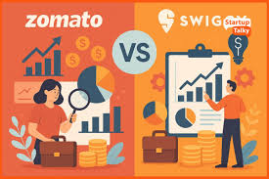
High Satisfaction: Average customer rating 4.1/5.
Consistent Delivery: Average delivery time 28 minutes meets standards.
Profit Drivers: High-value customers spend above average.
Customer Retention: Focus marketing on profitable segments.
Loyalty Programs: Prioritize high-value customers for rewards.
Data-Driven Strategy: Insights guide operational and marketing decisions.

Slide 18
T
H
A
N
K
Y
O
U

